Slide 1
PMMVYsoft MIS

Slide 2
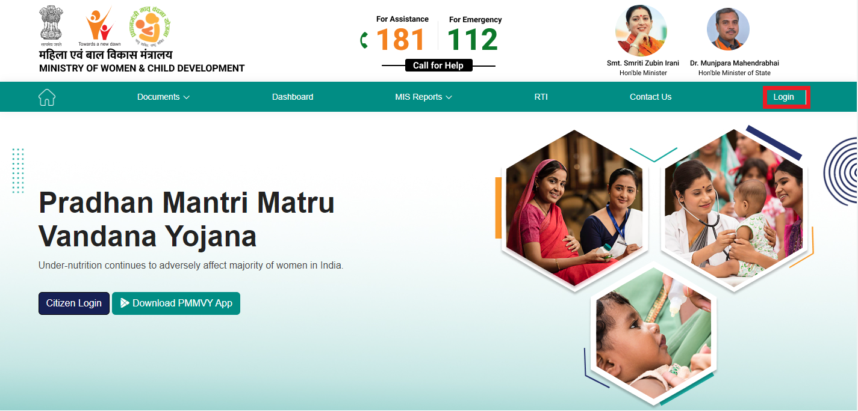
PMMVYsoft MIS Login Page
Users can login using this URL: https://pmmvy.nic.in for accessing the PMMVYsoft MIS application.
Click on LOGIN button available at the top right corner of the web application.

Slide 3
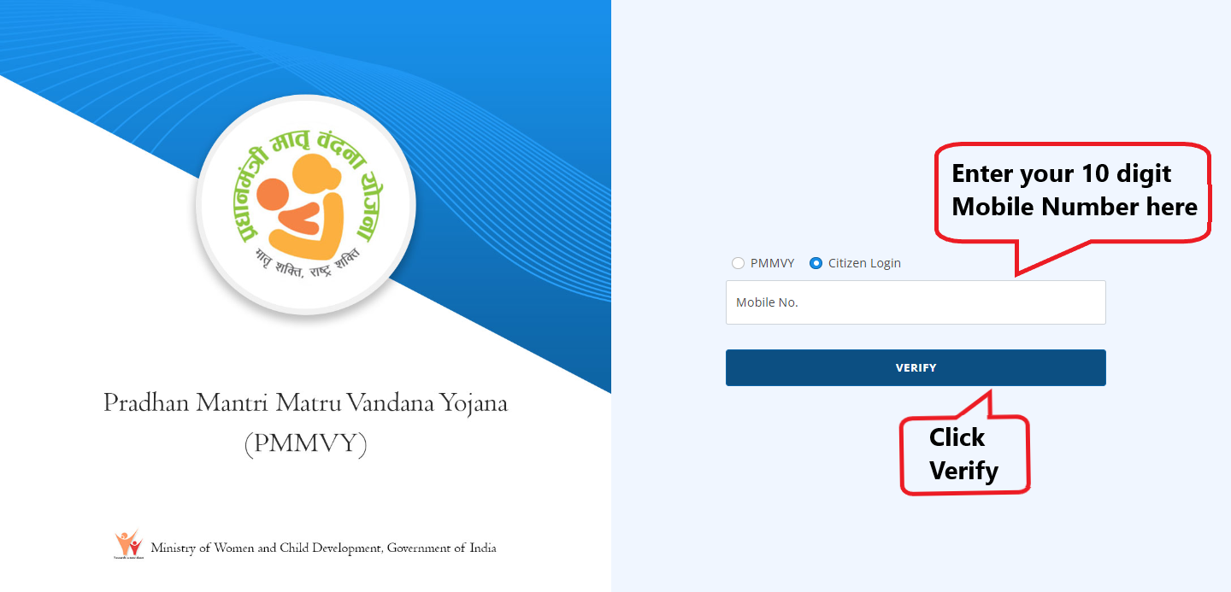
Citizen Login

Slide 4
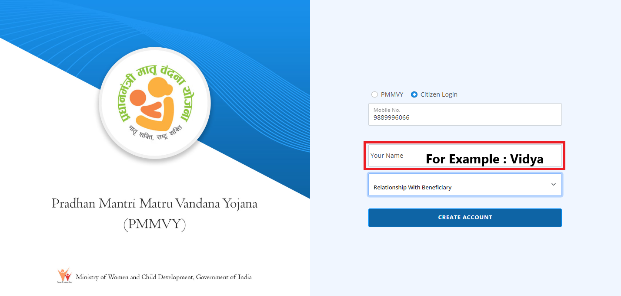
Citizen Login

Slide 5
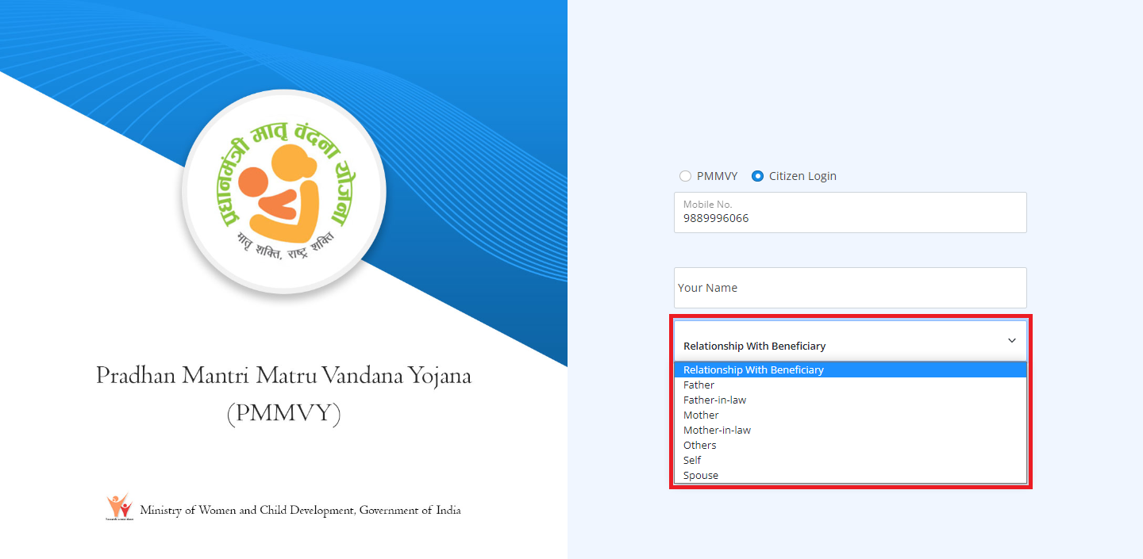
Citizen Login

Slide 6
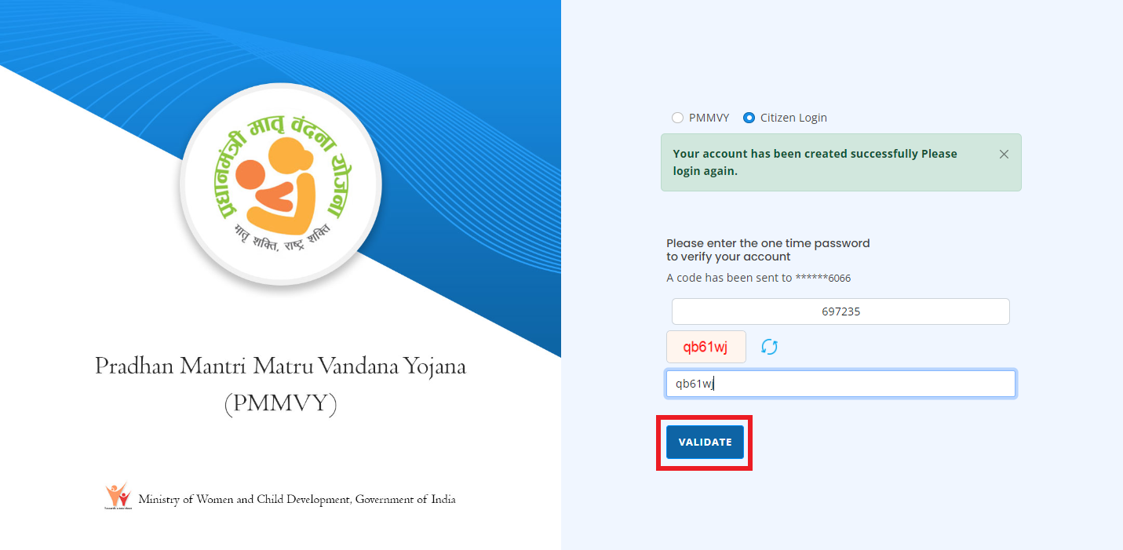
Citizen Login

Slide 7
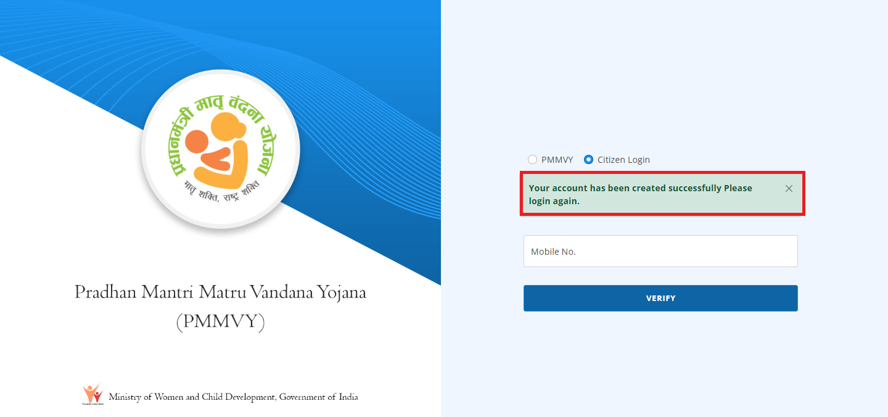
Citizen Login

Slide 8
Citizen Login

Slide 9
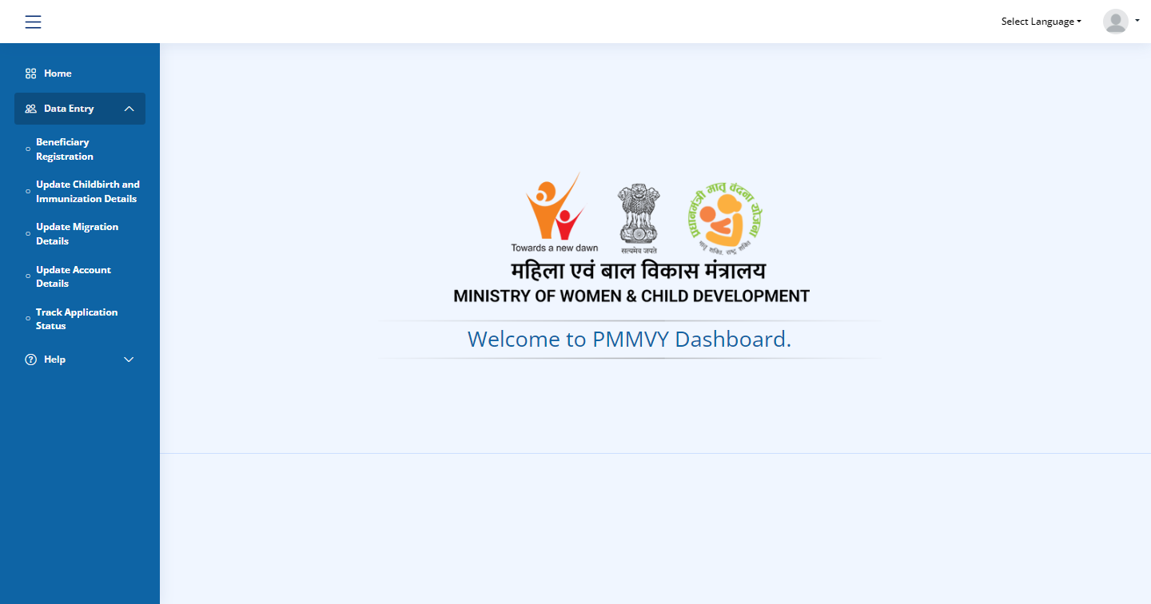
Citizen Login Home Page

Slide 10
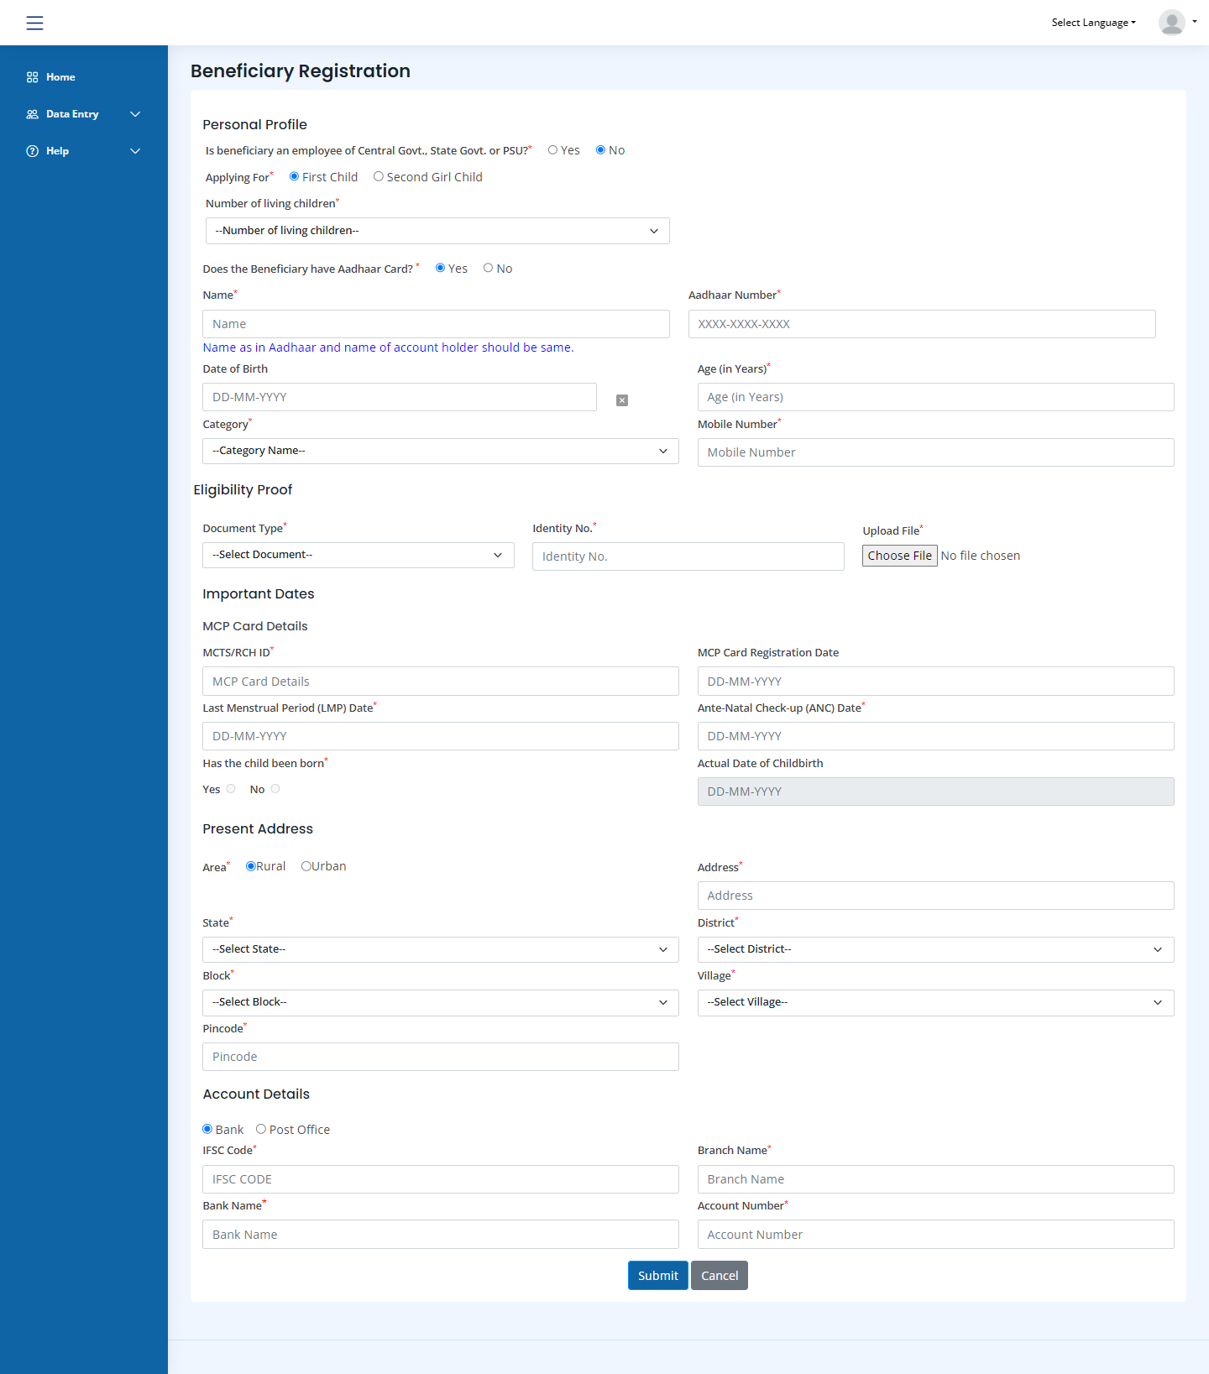
Beneficiary Registration from Citizen Login

Slide 11
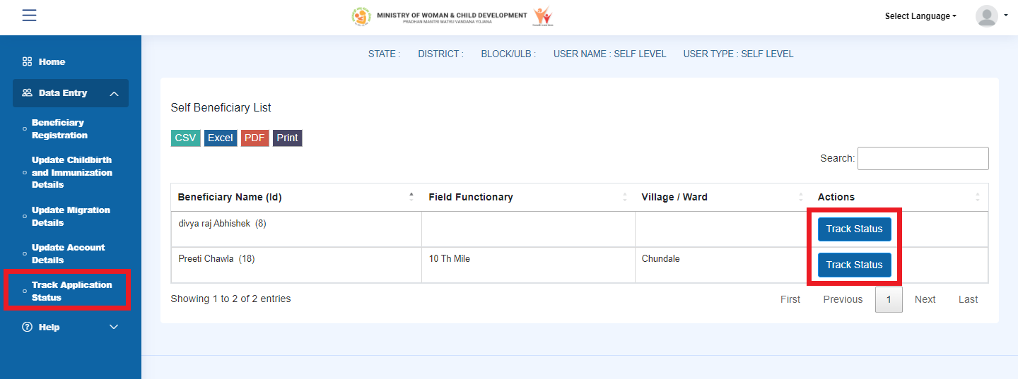
Track Application Status from Citizen Login

Slide 12
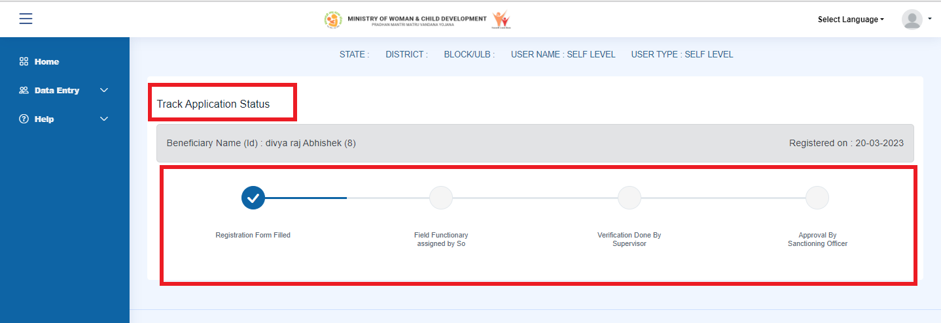
Track Application Status from Citizen Login

Slide 13
THANKYOU

